Slide 1
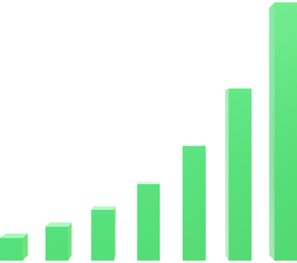
Employee Data Analysis using Excel
STUDENT NAME: YOGASRI.V
REGISTER NO: 312216412
DEPARTMENT: BCOM COMPUTER APPLICATION
COLLAGE: SHRI SHANKARLAL SUNDARBAI SHASUN JAIN COLLEGE FOR WOMEN

Slide 2



PROJECT TITLE
EMPLOYEES PERFORMANCE ANALYSIS USING EXCEL

Slide 3
AGENDA
PROBLEM STATEMENT
PROJECT OVERVIEW
END USERS
OUR SOLUTION AND PROPOSITION
DATASET DESCRIPTION
MODELING APPROACH
RESULTS AND DISCUSSION
CONCLUTION

Slide 4
PROBLEM STATEMENT
Many organizations struggle to effectively track and analyze employee performance data. This can lead to difficulties in identifying areas for improvement, making informed decisions, and fostering employee growth.
Lack of Data Integration
Data from various sources, like performance reviews, attendance records, and training logs, are often scattered and siloed.
Manual Analysis
Traditional methods of analyzing performance data rely on manual calculations and spreadsheets, which are time-consuming and prone to error
Limited Insights
Without robust analysis, organizations may miss crucial patterns and trends in employee performance, hindering effective decision-making.
Ineffective Feedback
Lack of data-driven insights can lead to subjective and inconsistent feedback, impacting employee motivation and development.

Slide 5
PROJECT OVERVIEW
This project aims to leverage the power of Excel to streamline employee performance analysis and unlock valuable insights. By consolidating data from multiple sources, applying various analytical tools, and visualizing key metrics, we can empower organizations to make data-driven decisions and drive positive outcomes.
Data Collection
Gather employee performance data from various sources, including performance reviews, attendance records, and training logs.
Data Cleaning & Transformation
Clean and transform the collected data to ensure accuracy and consistency, preparing it for analysis.
Data Analysis
Apply various Excel functions and tools to analyze the cleaned data, including descriptive statistics, trend analysis, and correlation analysis.
Visualization & Reporting
Visualize key insights using charts, graphs, and dashboards to provide a clear and concise representation of the findings.
Actionable Insights
Generate actionable recommendations based on the analysis, focusing on areas for improvement, talent development, and strategic decision-making.

Slide 6
WHO ARE THE END USER’S ?
This solution is designed to benefit a range of stakeholders within an organization, each with specific needs and perspectives.
HR Professionals | Managers | Employees
Gain insights to streamline talent management, identify high performers, and create targeted development programs. | Use data-driven feedback to guide employee performance, set realistic goals, and provide effective coaching. | Benefit from transparent performance feedback, individualized development plans, and opportunities for growth within the organization.

Slide 7
OUR SOLUTION AND ITS VALUE PROPOSITION
Our solution leverages the power of Excel to provide a comprehensive and user-friendly approach to employee performance analysis.
Visual ReCreate interactive dashboards and visualizations to present key findings, allowing stakeholders to easily understand and interpret the data.porting
Actionable Insights
Generate actionable recommendations based on the analysis, supporting decision-making on talent development, performance improvement, and strategic initiatives.
Data Consolidation
Integrate data from multiple sources into a single spreadsheet, streamlining analysis and providing a unified view of employee performance.
Advanced Analysis
Utilize Excel's powerful functions and tools to perform descriptive statistics, trend analysis, and correlation analysis, uncovering valuable insights.

Slide 8
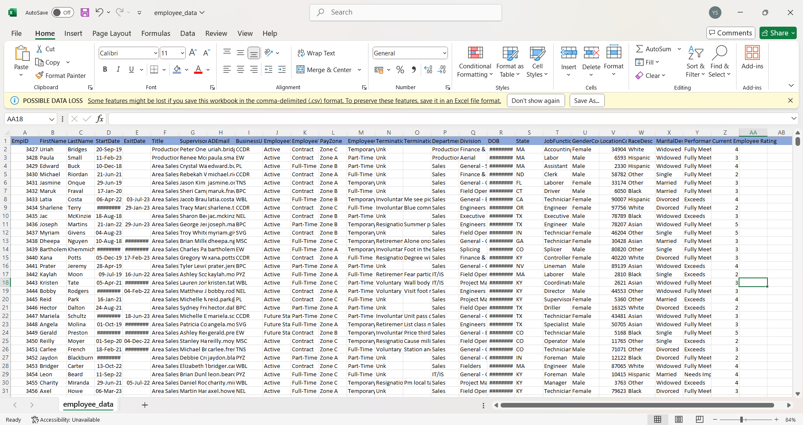
DATASET DESCRIPTION
The dataset used for analysis includes information related to employee personal details, job functions, employee status, and other relevant factors.

Slide 9
THE “WOW” IN OUR SOLUTION
Enhanced Performance
Identify areas for improvement, provide targeted training, and support employee growth, leading to increased productivity and engagement.
Data-Driven Decisions
Make informed decisions about talent acquisition, retention, and development based on objective data analysis.
Improved Communication
Promote transparency and open communication regarding performance expectations, feedback, and development plans.
Competitive Advantage
Gain a strategic advantage by developing a high-performing workforce that contributes to organizational success.
Beyond the technical aspects, our solution brings significant value by empowering organizations to unlock the potential of their workforce.

Slide 10
MODELING
The modeling process involves using various Excel functions and tools to analyze the dataset and extract meaningful insights.
Descriptive Statistics
Trend Analysis
Regression Analysis
Pivotal tables
Bar graph
Performance score(using slicers)

Slide 11
RESULTS

Slide 12
CONCLUSION By leveraging Excel's powerful analytics capabilities, we can unlock valuable insights into employee performance, enabling organizations to make data-driven decisions that optimize performance, drive success, and create a thriving work environment.
GenderCode | (All)
Count of FirstName | Column Labels
Row Labels | Exceeds | Fully Meets | Needs Improvement | PIP | Grand Total
BPC | 12 | 84 | 10 | 2 | 108
CCDR | 15 | 91 | 8 | 2 | 116
EW | 10 | 80 | 4 | 5 | 99
MSC | 13 | 86 | 5 | 2 | 106
NEL | 10 | 83 | 2 | 5 | 100
PL | 12 | 82 | 5 | 6 | 105
PYZ | 11 | 82 | 11 | 4 | 108
SVG | 11 | 79 | 4 | 2 | 96
TNS | 12 | 79 | 7 | 1 | 99
WBL | 14 | 77 | 9 | 1 | 101
Grand Total | 120 | 823 | 65 | 30 | 1038

